Slide 1
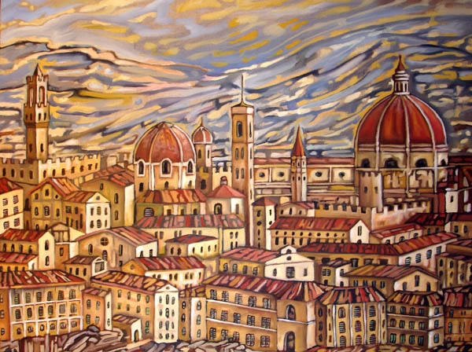
Centralization of
Power in the 1500s
By: Jessica Ji

Slide 2
Background
A centralization of power in four great states occurred along side the Age of Exploration in the 16th century. This period of time witnessed the emergence of several national powers and their highly structured state systems.
These rulers of England, France, and Spain in the late 15th and early 16th centuries set in place renewed royal authority that centralized power and formed the bureaucratic characteristics seen today.

Slide 3
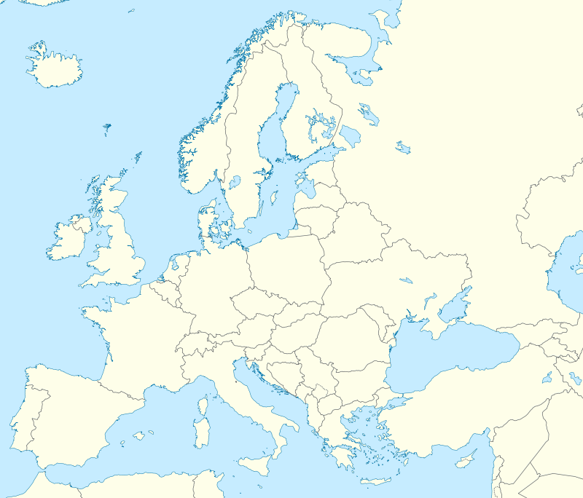
Click on the Links to view that state
Tudor England
Holy Roman Empire
Valois France
United Spain

Slide 4
Henry VII (1485-1509): Tudor England
Founded Tudor Dynasty after a period of chaos by the nobles
Founder of the Tudor Dynasty
  Came to the throne as victor of the War of Roses in 1485, during which the nobles had constantly ignored the orders of the monarchy.
Fixed Finances using a strong and relentless taxation system, and regulated trade with treaties.
  Treaty ex: Magnus Intercursus-trade in 1496 between England and Netherlands (Philip IV duke of Burgundy)
  Royal income rose from an annual average of £52,000 to £142,000 by the end of Henry's reign in 1509
Strengthened the power of the monarchy by using traditional methods of government to tighten royal administration
  Appointed gentry as local officers who helped administer the large state. These JP’s managed country laws (very efficient system)
  Had councilors serve on the Star Chamber where local lords and juries had no influence
Developed foreign relations by arranging marriages such as between his son Arthur and Catherine of Aragon in 1501, and after later wed widowed Catherine to Henry VIII in 1509
← Click the stars to learn more
←MAP

Slide 5
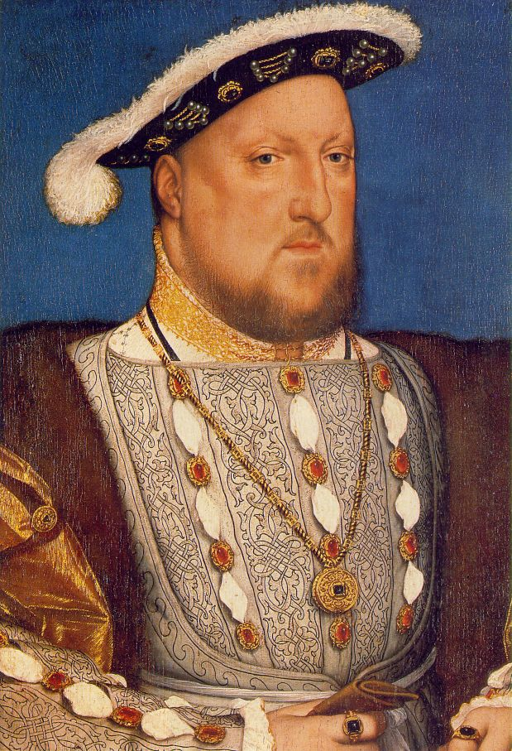
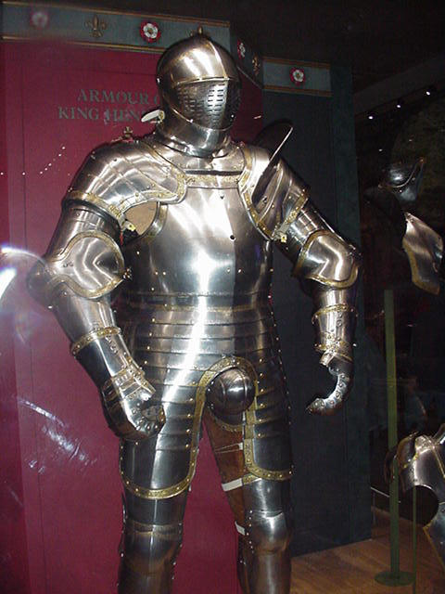
Henry VIII (1509-1547)
Consolidated Royal Power and separated from the Roman Catholic Church in 1534
Henry VIII inherited a stable realm with the his father's finances in a large surplus in 1509
  Parliament had not been summoned for supplies for five years
Induced in heavy spending & high taxation (Opposite from father)
  The monasteries' wealth had been spent on wars and had also built up the economic strength of the aristocracy and other families in the counties
He declared himself supreme head of the Church of England and broke with Roman Church in 1534 because Pope Clement VII refused to grant the divorce between Henry and Catherine of Aragon, forming the church of England
  This break in 1534 excluded the papacy and brought the clergy under control, strengthening the Crown's position and acquiring the monasteries' wealth.
  Secularized religious property
Invested in gunnery and created a permanent navy, though he did not establish a standing army
Appointed a Privy Council around 1510 and was made up of ‘Privy’ Counsellors - the elite King’s advisers - and Ordinary Counsellors - lawyers and administrators.
Henry VIII & His Suit of Armor
Learn
More about Henry VIII
←MAP
Read about Henry’s 6 Wives

Slide 6
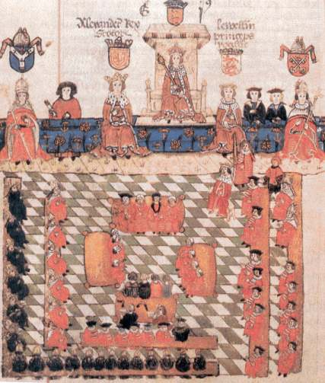
Tudor Government and Law
English Common law was secure as sovereign after the Reformation Parliament and break with the Roman Catholic church in 1534
  Because common law was stable, Parliament was as well, since the amendments and additions to this law were only made by statute. The need for legislation made Parliament a large role in the Tudor government.
  It was formed from precedent and tradition that was uniform throughout England.
  System of justice established by judges that traveled from one area to another.
Parliament garnered importance as main representation of the country’s wishes. It was especially active from 1509-1547 (Henry VII rule)
  Used to legitimize laws, usually regarding taxation, drafted by monarchs. However, these monarchs would call and dismiss Parliament whenever they needed it
  The consent of the Commons had become equally essential to that of the Lords, and in 1407 it was established that the Lords should merely agree to what had been granted independently by the Commons.
  By 1455, the Lords' power to amend financial bills to a reduction of the amount of a grant, not to its enhancement.
This privilege was threatened only twice in the Tudor period: in 1523, when Wolsey tried to take money from the Commons, stating that the Lords were willing to grant what was asked; and in 1593, when the Commons, having granted two subsidies, were forced to add another, because the Lords insisted on granting three.
Tudor England Parliament in Session
Extended Information about the English Parliaments
←MAP

Slide 7
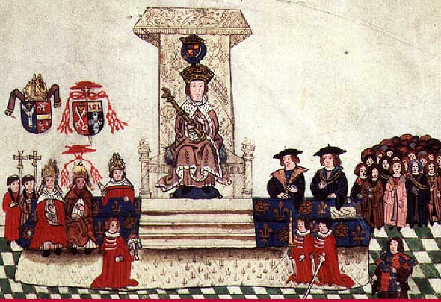
How did English Rulers manage their state?
Justices of the Peace (JP’s) owed their offices to the king. Justices of Peace (Non-nobility, land-owning men called Gentry) were the chief local government officers and were responsible for the maintenance of public order in their assigned area. Responsible for executing legislation written up in London, JP’s ensured that greater social unity and cohesion existed at a local level, and increased efficiency of England’s government
  This ensured the efficiency of government, as each JP worked very hard to be re-elected ( Each only served for one year at a time)
JP’s were used most frequently during the rule of Henry VII (1485-1509)
  Created a reliable, great administrative structure
At Quarter sessions, all JP decisions and serious court cases were reviewed
Learn
More about Henry VII’s JP’s
A Quarter Session during the reign of Henry VII
←MAP

Slide 8
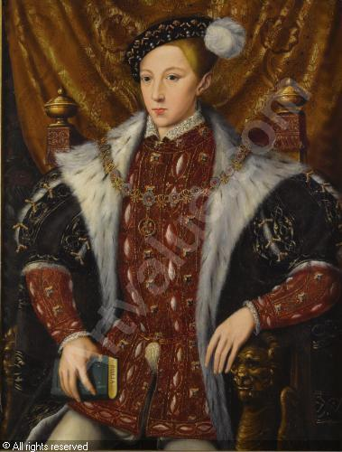
Valois France: Louis XI (1461-1483)
He inherited a country in chaos after the Hundred Years war ended in 1453. Royal authority had lost much control and the dukedom of Burgundy emerged as a new enemy
Louis XI had 4 desires that he wished to accomplish during his reign:
  1 - Establish a strong monarchy 2 - Instill law and order throughout the kingdom 3 - Execute prosperous trade throughout the land and overseas in foreign lands 4 - Create a successful reputation for France in countries abroad
Feudal nobility founded an alliance, called the League of Public Weal in 1465, in defiance of the central power, Louis XI. Led by Charles the Bold of Burgundy and Charles Duke of Berry, these nobles hoped to restore their feudal privileges
  The French Kings had effectively administered the unification of the country, however, this centralization was opposed by the League. Louis XI consolidated royal power by creating a coalition against the duke of Burgundy and finally defeated him in 1472, killing Charles the Bold in battle
  After annexing the duchy of Burgundy, Mary, he claimed much of the Low Countries. Louis won Anjou, Maine & Provence & expanded westward
Louis XI
Learn more about Louis XI
←MAP

Slide 9
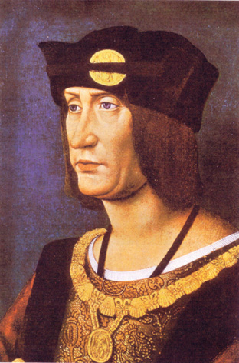
Charles VIII (1483-1498)
Foreign Policy:
Invaded the Italian peninsula in 1494, sparking a war against the Habsburgs over the peninsula
  Frightened by the speed and power of the French Advance, Italian Rules formed an anti-French coalition, the Holy League of Venice. Charles was finally defeated by the league after 65 years of conflict in 1495
  However, this Peninsular War helped Charles VIII consolidate royal power at home.
Because there was a lack of revenue to support the expeditions, Kings relied on bankers who helped shape France’s finance, which in turn, boosted French economy.
On his deathbed in 1498, Charles left France in much debt and disorder from his many wars and failed expeditions
  However he did strengthen cultural ties to Italy, such as renovating French art and letters
Domestic policy:
Exemptions from taxes such as the taille and the gabelle for many nobles, clergy, and royal officeholders forced the bulk of the taxes to be raised from the classes that had the least.
  Therefore, they began the selling of offices to provide revenue for crown. Positions were sold to purchasers who desired the status and tax exemption. This system expanded widely since its introduction under Louis XII (1498-1515)
  This selling of offices stimulated social mobility, dynasties of noble officeholders and a new administrative class, and caused a dramatic expansion of bureaucracies, therefore encouraging corruption.
Charles VIII
Read more about the Italian Wars
←MAP

Slide 10
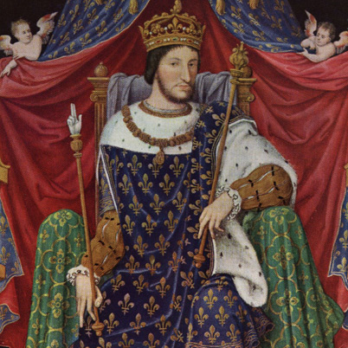
Francis I (1515-1547)
In the imperial election of 1519, Francis I attempted to succeed Maximilian I and ran as a candidate for the rule.
  However, when Charles I of Spain was elected Emperor Charles V, much territory came into Habsburg power that surrounded France on all borders. Thus, the French and the Habsburgs became enemies.
Francis I intensified absolute monarchy in 1520 and reorganized France’s government
  He legalized sale of offices and converted the nobility into more dependant peoples
  Governed with a convenient inner council of favorites, called the conseil des affaires. Both the Estates General and the Parlements did not meet.
  In 1530, he declared French the national language for the country
  He further strengthened royal power by supporting lit de justice This allowed Francis to persuade any assembly that was delaying any of his edicts.
In 1516, he persuaded pope to give crown the right to appoint all France’s bishops and abbots. Thus, all the revenue earned by the bishop went to the crown and the crown now controlled the French Church. A large patronage was now at Francis’ disposal which he could use to reward servants or raise money.
  This Concordat of Bologna brought clergy into subjection and stated that all royal courts were superior to those of the church
Francis I
More about the Concordat
←MAP

Slide 11
Valois France Administration
Rulers of France in the 15th century lacked a system of local government
  Aristocrats dominated regions and nobles became independent with their own courts and taxation
  The large size of the kingdom curbed royal power, preventing substantial communication from occurring between different parts of the realm
  The monarchy thought that royal family members that governed these distant provinces would solve the communication problem. However they were simply greedy for power
Estates general also limited power of the throne
  These bodies approved levels of taxation and other royal policies. Yet, the Estates General, France’s main representative body, could not function as a sufficient body of government, giving French kings more independence in regards to finance
  Years ago, consent from locals was required for certain taxes. But, after 1451, taxes could be collected on the King’s orders alone
The center of government was the royal council in Paris. Parlement of Paris remained a judicial body whose members were appointed by the crown.
  Provinces began creating their own parlements, symbolizing the diminishing power of the central authority
However, the dominance by Roman law (based on royal decrees) allowed monarchs to govern by ordinances and edicts and balanced the parlements
The standing army was the main source of power for the King
  Still, it burdened people with indirect heavier taxation and the upkeep of the troops required more than ½ the royal expenditures
  Strengthened royal authority as the army, although rarely used, was always a threat to opponents
Learn more about the rulers of Valois France
←MAP

Slide 12
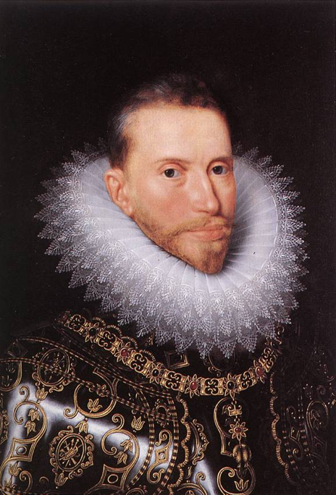
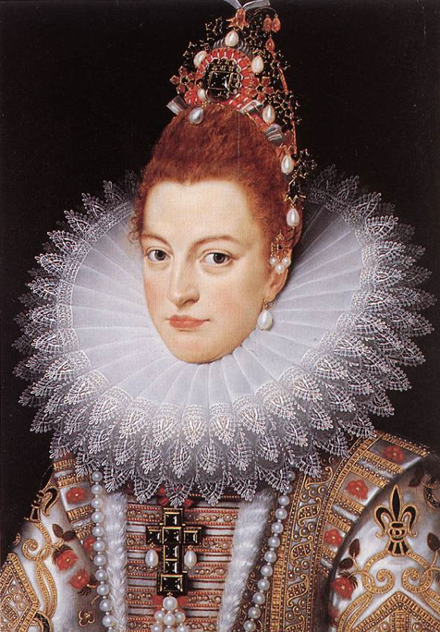
United Spain Centralization
Ferdinand & Isabella
They reformed the entire administration and reduced the number of nobles in the royal council, applying the principle that ability should be considered over social status when choosing office appointments
  The use of hidalgos (lesser aristocrat) increased in 1470 as they heavily depended on royal favor and were affected when they lost their tax exemptions. Thus, they were eager to serve the crown and assist in the centralization of power
The crown gained even more control of the nobility when the monarchs gained control over aristocracy’s military orders by 1500
  These wealthy orders pledged allegiance to their own elected leaders and to the aristocratic families. Although it was difficult to take over their leadership, the acquiring of the orders greatly strengthened Spain’s central authority.
Ferdinand & Isabella
Read about United Spain’s background and Isabella & Ferdinand
←MAP

Slide 13
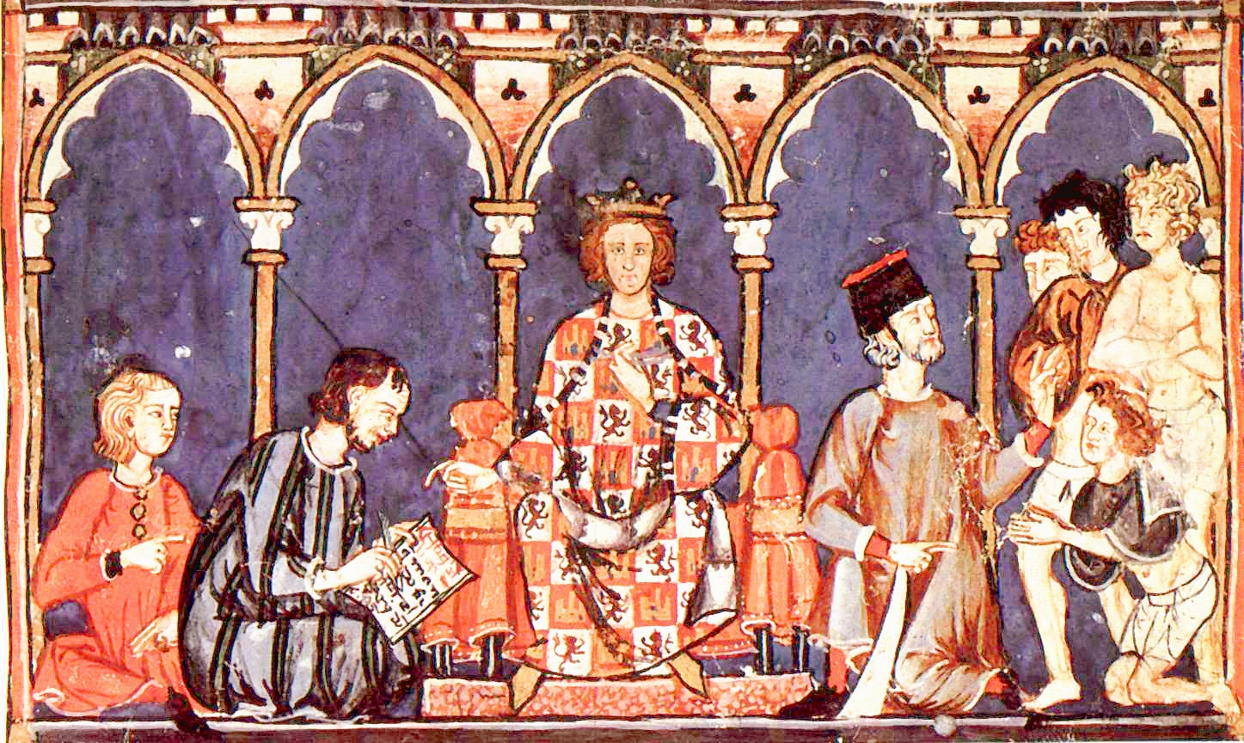
United Spain Administration
The monarchy governed far regions with Corregidors, which were similar to the Justices of Peace in England. These corregidors became chief executive and judicial officers in their regions and supervised town issues.
Cortes of Castile was an assembly dominated by urban representatives that wished or order for the benefit of trade and succeeded in terminating crimes in the kingdom in 1490s
They mastered the Cortes of Castile and the Castilian assembly
  Castilian Law was organized into a uniform code and remained in effect for centuries
  Much like most roman law systems, the justice system was supervised by monarchs, who had the power to override all local courts, run by nobles.
Ximenes, archbishop of Toledo, created 5 councils for administration of affairs
  royal council: chief court of justice
  council of the supreme: ecclesiastical business
  council of the orders: great military fraternities
  council of Aragon: management of Spain & Naples
  council of the Indies: for the great discoveries of Columbus
More about United Spain and the 5 councils
Cortes of Castile in session
←MAP

Slide 14
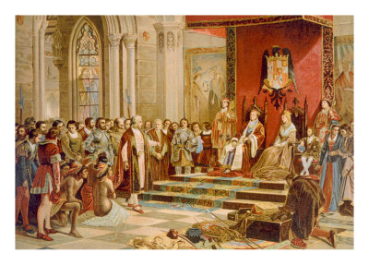
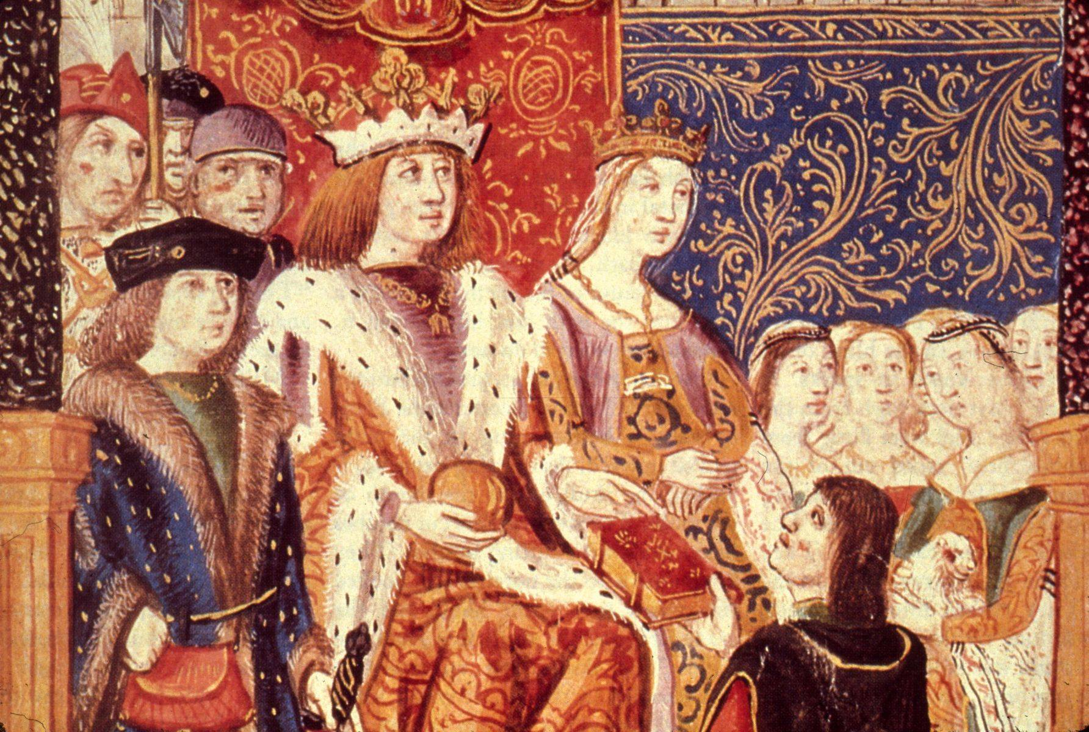
United Spain Monarchy
In 1469, Ferdinand, the future king of Sicily and Aragon married Isabella, the future queen of Castile, thereby uniting the provinces into the Kingdom of Spain
  Jointly assumed the thrones of Castile in 1474 and Aragon in 1479, thereby weakening the Castilian nobles. This ensued in a 10-year civil war in which the nobles’ faction was led by Alfonso V of Portugal.
  Finally, the nobility admitted defeat by the Treaty of Lisbon in 1479. the two monarchs emerged victorious, creating United Spain
  Muslims had the Iberian Peninsula for more than 700 years. After a 10-year battle to unite their land under Christian leadership, the monarchs finally defeated the Muslims in January 1492.
Aragon was a federation of territories governed by viceroys who kept local customs but were appointed by the king.
  Governed by consent and preserved rights of people in this kingdom. Each province had its own representative assembly called the Cortes.
Castile was restored to order the countryside that had been destroyed by civil war.
  They also attempted to reduce noble power
Ferdinand & Isabella
Click to watch a short video about Ferdinand & Isabella
←MAP

Slide 15
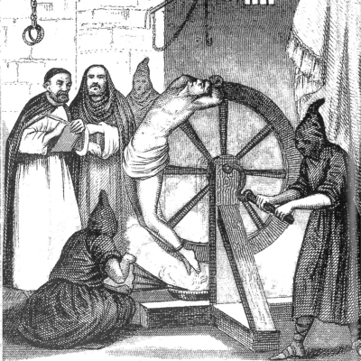
Achievements & Religious Affairs
Economics:
  Control over military orders & bureaucracy helped improve finances. The yield of the sales tax (alcabala), the main source of royal income, rose dramatically after the 1490s. Total revenue rocketed from 80,000 ducats in 1474 to 2.3 million in 1504.
Military and Diplomats:
  Ferdinand strengthened standing
  army and made it the most effective in Europe, as it soon dominated Italy
  Ferdinand founded a diplomatic
  system that centered on 5 permanent embassies. These ambassadors’ reports and activities made him the most informed ruler of international European politics
Relations with the Church
  Pope granted monarchy right to make church appointments in Southern Castile in 1492, weakening the church and making Spain more independent than any other state
Religious Wars
  Driving Muslims from Castile in 1479 helped create Spanish loyalty toward the monarchy & helped occupy restless nobles.
  Monarchy used religious uniformity to strengthen political uniformity
  Expelling of Jews in 1492 stimulated passion for crown’s authority by targeting a visible and often persecuted minority
  Based on this principle, the Inquisition was formed in 1483 to remove all Conversos and Moriscos –converted Jews and former Muslims-who were suspected of practicing old beliefs
  In 1609, the Moriscos were exiled from Spain. Yet, the persecution created religious unity and enhanced monarchy.
More on the achievements, including the Inquisition
←MAP

Slide 16
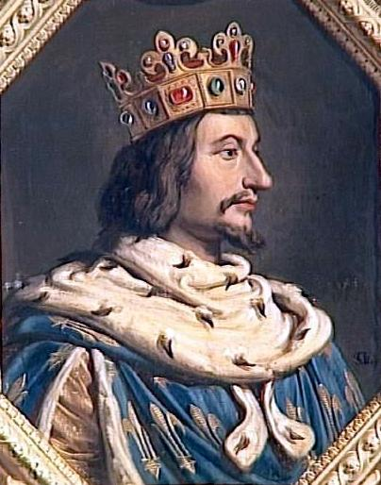
Holy Roman Empire: Charles V
Became ruler after death of Maximilian in 1519 and won the imperial election of 1519
Endured much criticism as HRE, as he spoke no Castilian and placed members of his Flemish assistants in government positions, igniting the anger of the nobility
  He was feared to be an absentee ruler with little interest in home affairs. Thus, revolts began to break out in Spain’s towns around 1520, and these troubles were among many that Charles would encounter. However these communes began to resent not only the monarch, but also social issues, leading to the resentment of privilege among the nobility
Charles had too many commitments and was ceaselessly at war. He could not remove local independence and restore royal authority.
  Although he made sure his entire administration was Spanish, his subjects felt that most of Charles’s wars helped his ambitions as emperor, but had no relation to Spain.
  His son, Phillip II, succeeded him and ruled Spain while the Habsburg and HRE dominions were handed to his uncle, Ferdinand I
Charles was away from Spain for many years. His representatives, in his absence, enlarged the bureaucracy and system of councils in the 1520s that had begun under Ferdinand and Isabella.
  There were two types of council & one for each department of government. The other was for each territory that the crown ruled (Aragon, Castile, Italy, the Indies, and the Low Countries. All councils reported to the king but ran independently in his absence.
  Viceroys in every large area controlled the administration under the supervision of the audencia (territorial council). Communication was slow, but the detailed centralization increased power.
Charles V
Much additional info on Charles V
←MAP

Slide 17
Holy Roman Empire: Government
Finances:
  The Habsburgs’ constant wars increased the burden on Spaniards and was not equally distributed among provinces. The only aspect that saved Charles’s finances were the influx of treasure from America. Charles was receiving about 800,000 ducats of treasure each year.
Princes ruled local cities and had a substantial amount of wealth, as many were located near the Rhine river.
  Princes of HRE ignored central government as they gained a strong foothold in Holy Roman Emperor territories. Selfish for personal power, these princes ruled cities that were independent from the emperor, preventing him from using their wealth/services.
Only the Diet worked alongside the emperor. Consisting of three assemblies, representatives of the cities, the princes, and the seven electors who elected the new emperor, the princes were able to use its legislation to secure their position again cities and lesser nobility.
In 1945, Charles V created a tribunal to settle disputes among local powers.
  Financed by princes, it ended lawlessness and its use of Roman Law influenced legislation and justice.
Other reform attempts failed because of the tightened hold of other princes on personal territories
  Religious dissension of the Reformation worsened Charles’ rivalries and divided the princes. His many commitments lead to his failure to build a strong centralized government.
←MAP

Slide 18

Works Cited
"All About Romance Novels - An Introduction to Early Modern European History (16th
& 17th Centuries)." All About Romance Novels - An Introduction to Early Modern European History (16th & 17th Centuries). N.p., n.d. Web. 18 Dec. 2012.
"British History Timeline." BBC News. BBC, n.d. Web. 18 Dec. 2012.
Chambers, Mortimer. 9th ed. Vol. 1. N.p.: McGraw Hill, 1974. Print.
"Charles V, Holy Roman Emperor (1500-1558) â GAMEO." Charles V, Holy Roman
Emperor (1500-1558) â GAMEO. N.p., n.d. Web. 18 Dec. 2012.
"Charles VIII." Charles VIII. N.p., n.d. Web. 18 Dec. 2012.
"Francis I." Francis I. N.p., n.d. Web. 18 Dec. 2012.
"Henry VII and JP's." Henry VII and JP's. N.p., n.d. Web. 18 Dec. 2012.
"History of the Monarchy The Tudors Henry VII." History of the Monarchy The Tudors
Henry VII. N.p., n.d. Web. 18 Dec. 2012.
The End

Slide 19
Works Cited (cont.)
"Isabella and Ferdinand." PBS. PBS, n.d. Web. 18 Dec. 2012.
"Louis XI." Louis XI. N.p., n.d. Web. 18 Dec. 2012.
"Parliament of England." Wikipedia. Wikimedia Foundation, 15 Dec. 2012. Web. 18 Dec.
2012.
"Philip II." Philip II. N.p., n.d. Web. 18 Dec. 2012.
"Spanish History - United Spain under Ferdinand and Isabella (1479-1516)." Spanish
History - United Spain under Ferdinand and Isabella (1479-1516). N.p., n.d. Web. 18 Dec. 2012.
"The Tudors - Tudor Parliaments." The Tudors - Tudor Parliaments. N.p., n.d. Web. 18
Dec. 2012.
"Tudor England- Great Britain." Questia- Trusted Online Search. N.p., n.d. Web. 18 Dec.
2012.
Digital Images:
Alfonso X 'The Wise' and His Court. Digital image. Via Podiensis. N.p., n.d. Web.
England Parliament. Digital image. UK History. N.p., n.d. Web. 18 Dec. 2012.
Charles V of France. Digital image. Historum.com. N.p., n.d. Web. 18 Dec. 2012.
Charles VIII. Digital image. Sovereigns De La France. N.p., n.d. Web. 18 Dec. 2012.
Francis I. Digital image. Biography.com. N.p., n.d. Web. 18 Dec. 2012.

Slide 20
Works Cited (cont.)
Henry VII. Digital image. Duhaime.org. N.p., n.d. Web. 18 Dec. 2012.
Henry VIII. Digital image. Free Info Society. N.p., n.d. Web. 18 Dec. 2012.
Henry VIII Suit. Digital image. En Vacances. N.p., n.d. Web. 18 Dec. 2012.
Isabella Clara Eugenia. Digital image. Academic. N.p., n.d. Web. 18 Dec. 2012.
Louis XI. Digital image. NNBD. N.p., n.d. Web. 18 Dec. 2012.
Map of Spain from Late 1500s. Digital image. Ebay.com. N.p., n.d. Web. 18 Dec. 2012.
Parlement of Paris. Digital image. Wikispaces. N.p., n.d. Web. 18 Dec. 2012.
Rooftops of the Duomo. Digital image. Absolute Image. N.p., n.d. Web. 18 Dec. 2012.
Royal Couple - Isabella and Ferdinand, 1469. Digital image. About.com. N.p., n.d. Web.
18 Dec. 2012.
The Inquisition. Digital image. My Adventures in Espana. N.p., n.d. Web. 18 Dec. 2012.
The Inquisition. Digital image. Wynn Place or Show. N.p., n.d. Web. 18 Dec. 2012.
Tudor England. Digital image. Family Ancestry. N.p., n.d. Web. 18 Dec. 2012.
Tudor TimeLine. Digital image. Colchester Treasure Hunt. N.p., n.d. Web. 18 Dec. 2012.

